Slide 1
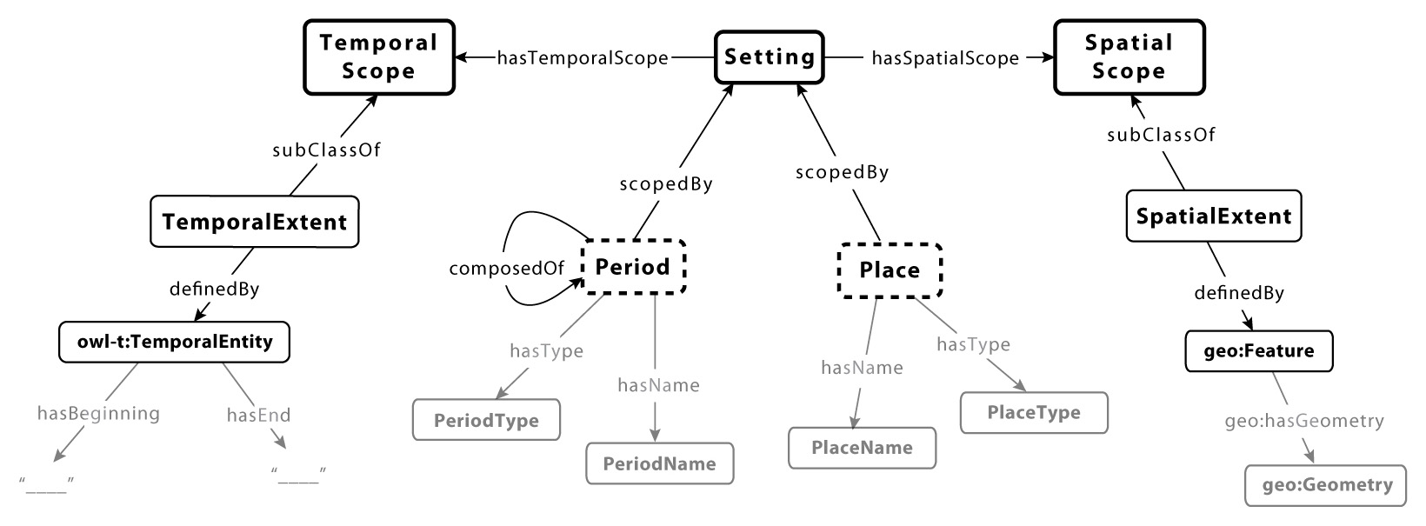
Topotime: Joining Place and Period for Historical Gazetteers
Karl Grossner, PhD Center for Interdisciplinary Digital Research Stanford University
http://github.com/kgeographer/topotime

Slide 2
Notes:
I illustrate an abstract conceptual model here -- an ontology design pattern described in a book chapter I recently co-authored with Jano and Carsten
To say space and time are entirely intertwined should not be a controversial subject, but there are differences of opinion as to whether we should care—or at least whether our data models should reflect that fact explicitly
-- but this talk is about very practical consideraations, and I begin there. I’ll work back to the pattern

Slide 3
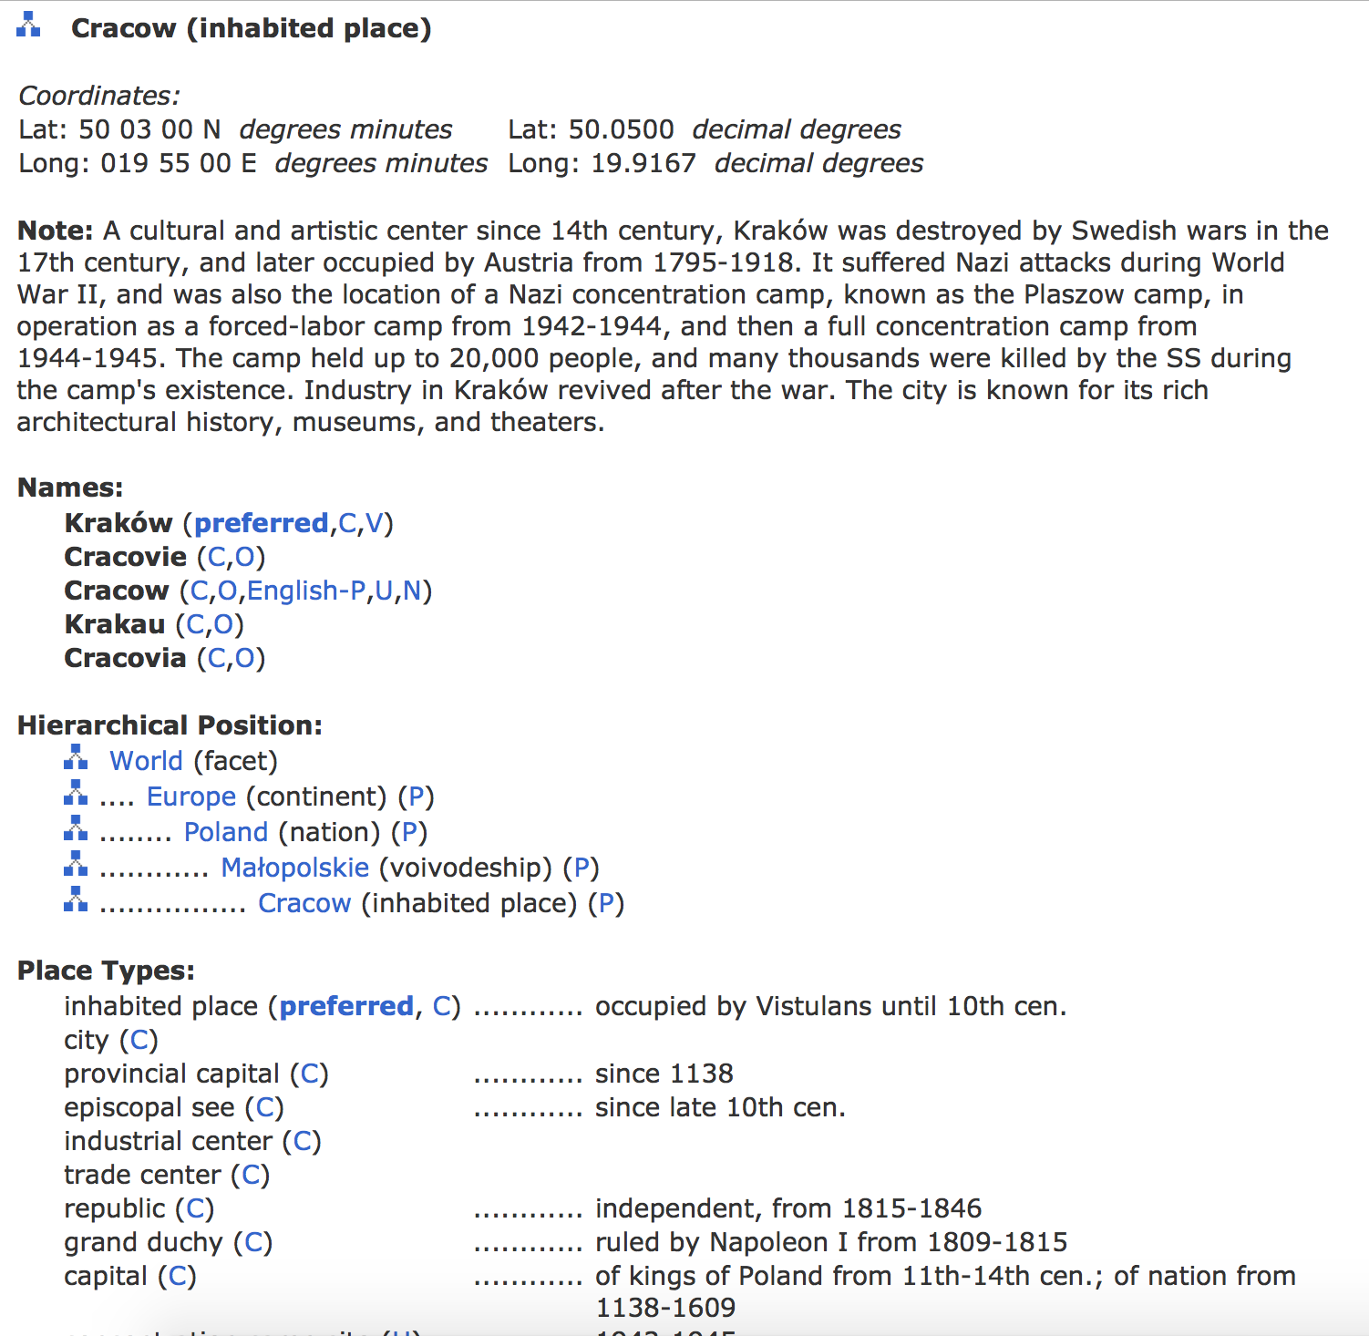
Getty Thesaurus of Geographic Names
Notes:
of course we all want temporal information along with our historical spatial information, but our gazetteers aren’t quite there yet – at least the biggest ones aren’t (kudos to Pleiades and others who are). It’s worth noting that requirements depend on eras of focus, different for the Ancient World than the Modern one, or even Medieval time
Getty has some time, but it is not sufficiently structured to be of much use to digital humanists.
This talk is about joining place and period – space and time – in conceptual, logical data models and data schemas. Also managing uncertain extents. Many precepts I talk about are not new, but I think the premise of Topotime is, and I’ve certainly heard more positive feedback about my ATTEMPT to move it forward than any other research I’ve talked about publicly

Slide 4
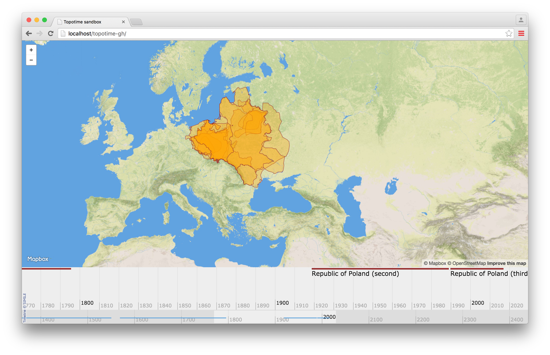
source: Euratlas Periodis Web, http://www.euratlas.net/history/europe/
Notes:
I’m going to start at the front end, because frontend requirements are a good place to start in software design
I put together this Leaflet/Timeline software to parse Topotime data for Places, for Periods, also for Movement data, like journeys, routes, and flows
Places, like several incarnations of Poland—Polish states: a region called “Slav Polan Lordships,” a “Duchy of Poland,” a “Principality of Polotsk,” a “Kingdom of Poland,” two Republics of Poland, and so on
This gap was one of two long periods during which there was no Polish state

Slide 5
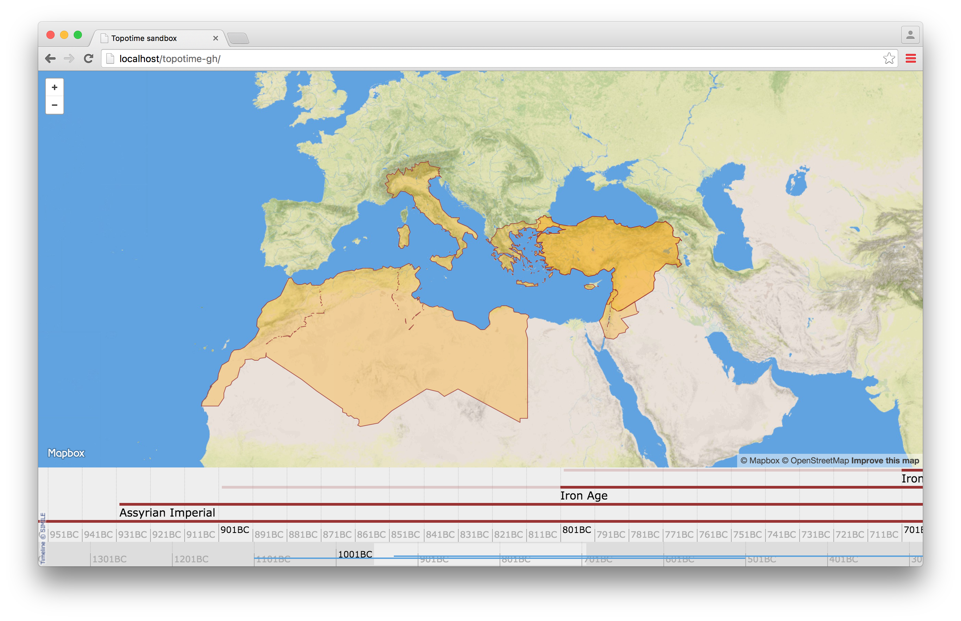
PeriodO data source: http://n2t.net/ark:/99152/p0tns5v, cf. Hodos (2006). Local Responses to Colonization in the Iron Age Mediterranean
Notes:
Places are not unlike Periods: these are four related periods from a collection contributed to the PeriodO project, including multiple takes on “Iron Age” with diferent geographies. I’m interested in developing a data model, and associated standard formats, for representing both Places and Periods – and I’m finding they have nearly identical requirements. If you think of the Far East, consider that Ming China is very much both a Period—a Dynastic reign—and a place
I’m also very keen on mapping both Place and Period, intermingled, and visualizing them on timelines. Beyond that, in computing over them. Imagine laying a million events on this canvas of Place and Period and analyzing the differential nature of events occuring within containing Places and Periods.
So even though joining space and time has proven difficult – as GIScientists and GIS users alike will tell you, GIS doesn’t do time well—it’s worth pursuing, and the means for doing so have improved in recent years.

Slide 6
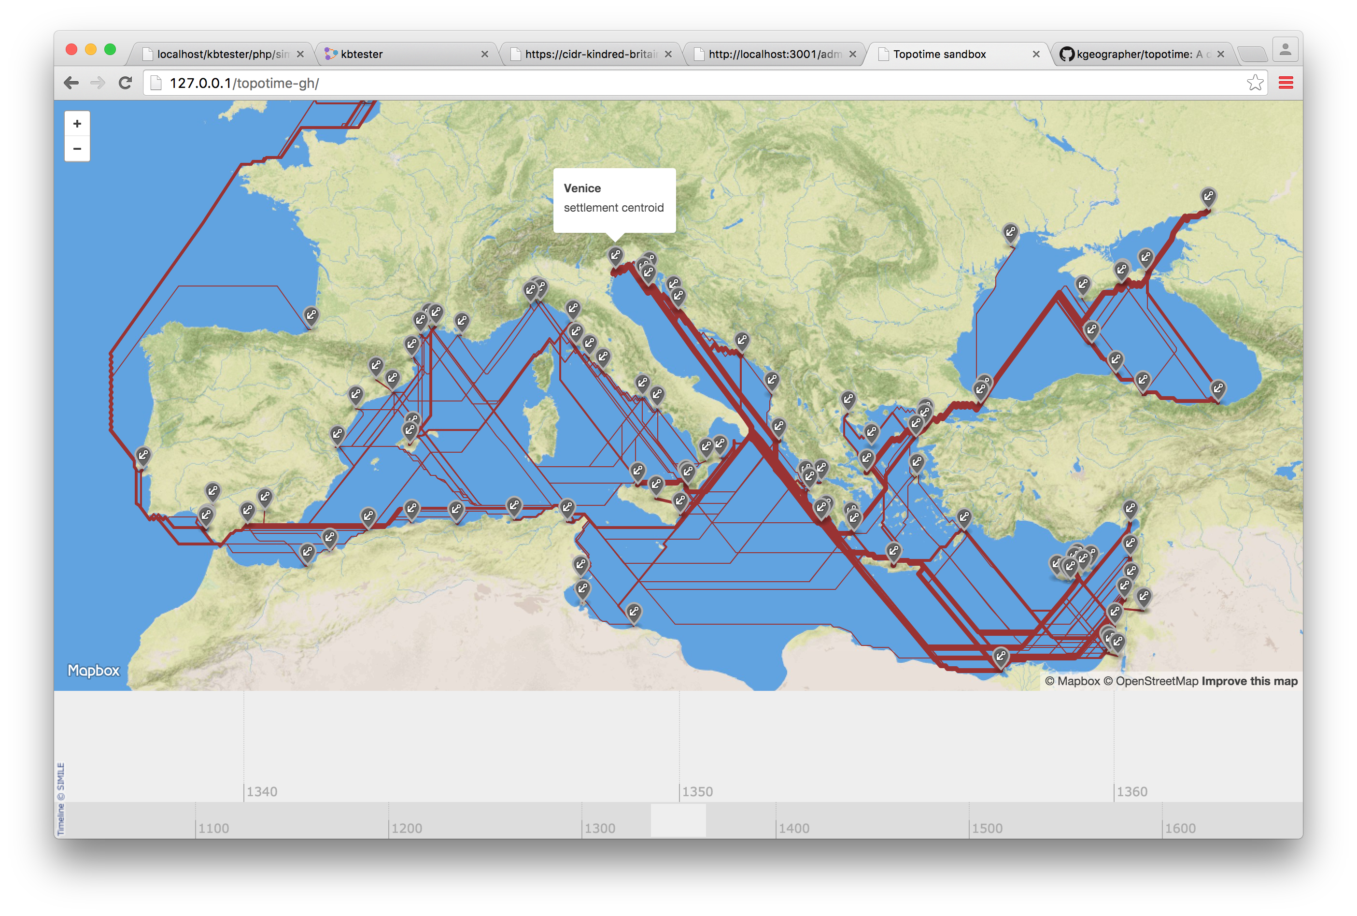
The Orbis Initiative
source: Venetian Incanto Trade 1283-1453CE, courtesy Mélanie Fournier
Notes:
Topotime can also represent movement data, as it will for the Orbis Initiative: journeys, routes, and flows of people, commodities, information – as well as the physical media they move over, what I call ways (including roads, rivers, canals, trains, ocean currents). This effort just was awarded a micro-grant from the Pelagios Commons – work I will do with Rainer Simon and Lex Berman of Harvard’s CGA.

Slide 7
{
"type": "FeatureCollection",
"properties": {
"id": "euro_poland",
"label": "Admin bounds collection: euro_poland"
},
"features": [
{
"type": "Feature",
"properties": { },
"geometry": { },
},
...
]
}
GeoJSON
Notes:
take GeoJSON, please. But seriously...it is a spatial data formatting standard. Wildly succesfull, due in large part to the fact people can move around and share human-intelligible text files, and there is software for making maps that interprets it – it is a widely-supported supported data format
But it doesn’t do time...

Slide 8
{
"type": "FeatureCollection",
"properties": {
"id": "euro_poland",
"label": "Admin bounds collection: euro_poland"
},
"features": [
{
"type": "Feature",
"properties": { },
"geometry": { },
"when": { }
},
...
]
}
Topotime
Notes:
after trying a few things in concert with my former colleague E. Meeks, I got it in my head to try something relatively much simpler: add when to GeoJSON. A format that could be read by time-map software to render maps and timelines from the same dataset.
but it’s not that simple, for example when we’re modeling places that changed over time...we could make as many Features as there are changes, or...

Slide 9
"features": [
{
"type": "Feature",
"properties": { },
"geometry": {
“type”: “GeometryCollection”,
“geometries”: [
“type”: “MultiPolygon”,
“properties”: { },
“coordinates”: [ ],
“when”: { }
]
},
},
...
]
}
Topotime
Notes:
we could represent a place (like Poland) as a single Feature, with a geometry that changes over time

Slide 10
“when”: {
"timespans": [
{
"label": { "eng_latn": "Iron Age“ },
"start": {
"earliest": "-0899",
"label": "ninth century BC",
"latest": "-0800"
},
"end": {
"earliest": "-0499",
"label": "fifth century BC",
"latest": "-0400"
},
"type": "throughout“
]
}
Topotime
Notes:
what a when object looks like

Slide 11
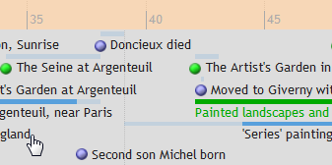
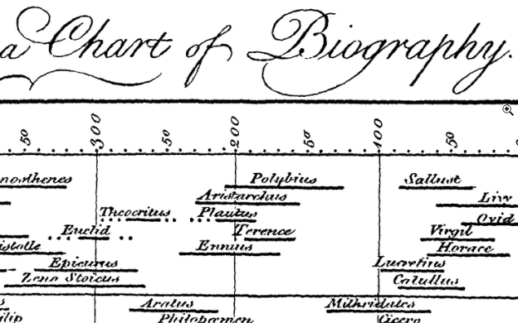
SIMILE Timeline
2006
Joseph
Priestley
1765

Slide 12
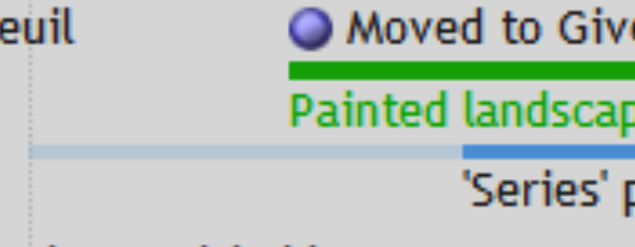
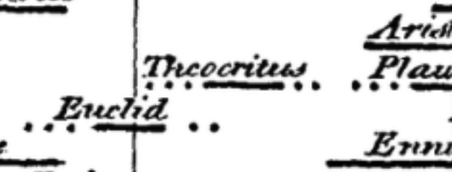
Notes:
First question – when does something begin and end

Slide 13
Determining relevance of imprecise temporal intervals for cultural heritage information retrieval
Tomi Kauppinen, Glauco Mantegari, Panu Paakkarinen, Heini Kuittinen, Eero Hyvonen, Stefania Bandini
Int. J. Human-Computer Studies 68 (2010) 549–560
10 yrs
14 yrs
The period ‘‘from around the beginning of the I century B.C. to the first half of the I century A.D.’’ represented as a fuzzy temporal interval.
Notes:
There have been several excellent models of imprecise intervals developed recently, Kaupinnen et al is one…
Area under curve is meaningful, and extent of overlap can be a probabilistic staement of co-occurrence

Slide 14
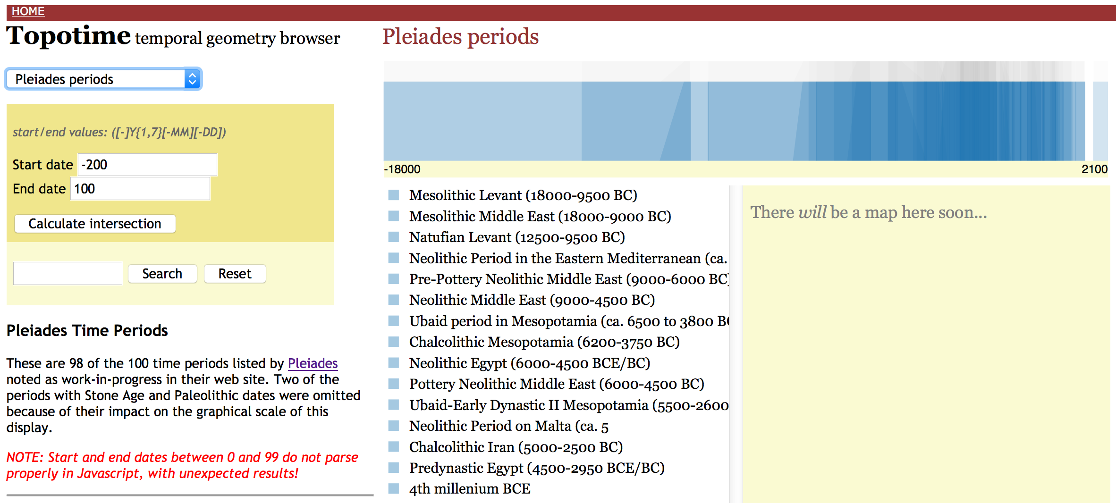
http://dh.stanford.edu/topotime/demo_py.html
Notes:
A visualiation from the first, probably overly ambitious stab at Topotime

Slide 15
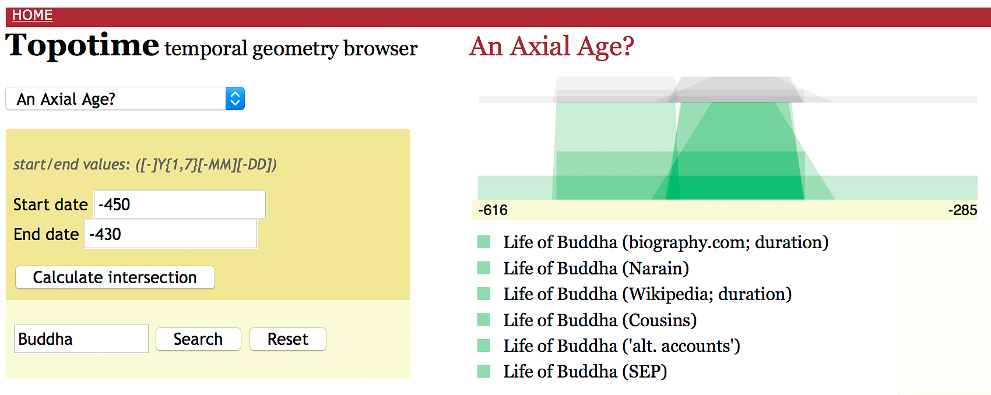
http://dh.stanford.edu/topotime/demo_py.html

Slide 16
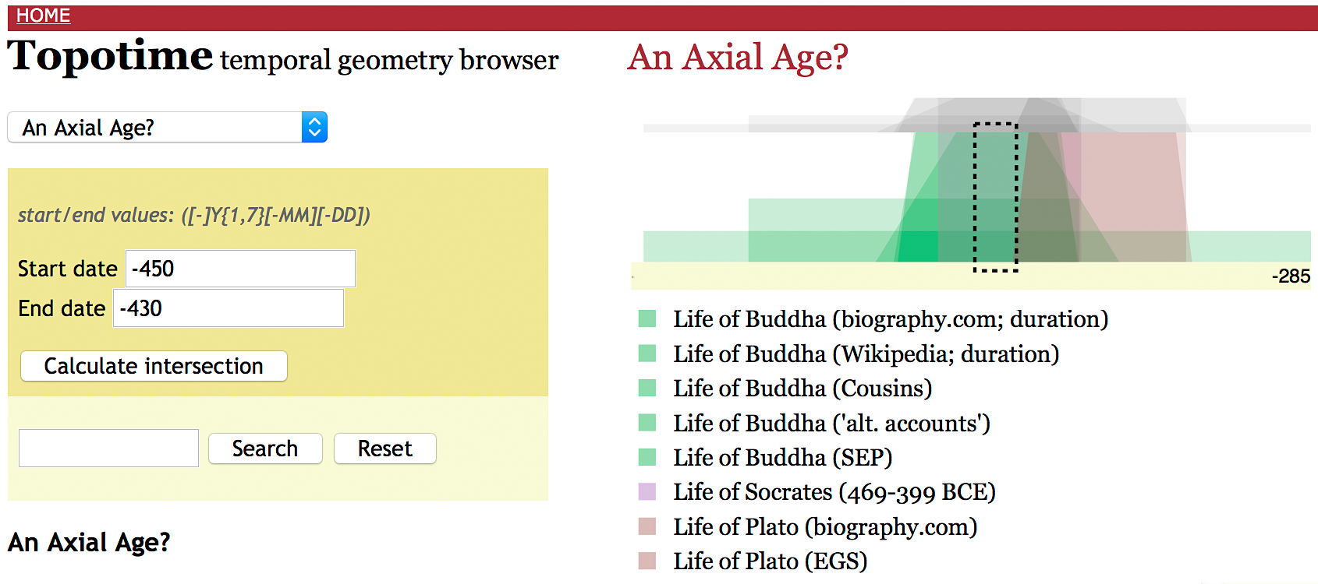

Slide 17
PeriodO data source: http://n2t.net/ark:/99152/p0tns5v, cf. Hodos (2006). Local Responses to Colonization in the Iron Age Mediterranean
Notes:
that sort of temporal information could be reflected in the timeline portion of this visualization, as it is here
and if spatial extents for periods were “fuzzy” ones, derived from find locations associated with them – “Late Minoan” for example – we could indicate that on maps and compute some interesting probabilistic co-occurences
at any rate, we’ll have moved to a more “robust” geo-historical information system

Slide 18
http://github.com/kgeographer/topotime

